Slide 1



X
Performance Analytics
Kimia Farma - Big Data Analytics
Presented by
Suci Wulan Dari

Slide 2






Suci Wulan Dari
Final year informatics engineering student at Lhokseumawe State Polytechnic who has an interest in data analytics. Able to solve problems and think critically. Currently looking for internship experience specifically in data analysis to open
career gateway.
Lhokseumawe, Aceh
suciwd3@gmail.com
https://www.linkedin.com/in/suci-wulan-dari/
https://github.com/suciwuland

Slide 3
Courses and Certification
MSIB Batch 4 Web Developer, Soca AI | link certificate July, 2023 Introduction to Data Analytics, IBM - Coursera | link certificate June, 2023 Analyze Data to Answer Question, Google - Coursera | link certificate February, 2023 Google Data Analytics Capstone - Coursera | link certificate February,2023 Intro to Data Analytics - Revou | link certificate February, 2024

Slide 4

About Company
Kimia Farma is a leading pharmaceutical company in Indonesia with more than two centuries of experience in the industry. The company is known for its strong reputation for quality healthcare products and services. Kimia Farma offers a variety of career opportunities in various fields such as production, distribution and retail of medicines. This company also has an extensive branch network throughout Indonesia. Kimia Farma emphasizes human resource development by providing training and development programs for employees. Joining Kimia Farma provides the opportunity to become part of the dynamic pharmaceutical industry and contribute to improving the quality of health of the Indonesian people.

Slide 5
Project Portfolio
As a Big Data Analytics Intern at Kimia Farma, my main project is to evaluate the company's business performance from 2020 to 2023. This evaluation aims to provide in-depth insight into business trends and conduct relevant analysis to assist strategic decision making in the company. Using the available data, I will create an analysis table using BigQuery and a business performance dashboard using Google Looker Studio.
There is a dataset consisting of 4 CSV files, namely: Contains information about the final transaction, Contains information about the company's inventory, Contains information about the company's branch offices, Contains information about products for sale.
Problem Statement Summary:
Import data into BigQuery: The available dataset will be imported into BigQuery and tabled for further analysis
Create an Analysis Table: The aggregation results of the four datasets will be entered into an analysis table that includes important information about transactions, products, branches, etc
Creating a Business Performance Dashboard: Using Google Looker Studio, a business performance dashboard will be created based on the previous analysis table.
Project explanation videohere!

Slide 6
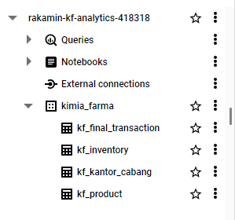
Importing Dataset to BigQuery
In analyzing the performance business of Kimia Farma, a relevant dataset is needed, for this we obtained 4 CSV files which were then imported into big query with the project name Rakamin KF Analytics and a dataset called kimia farma for further processing.

Slide 7
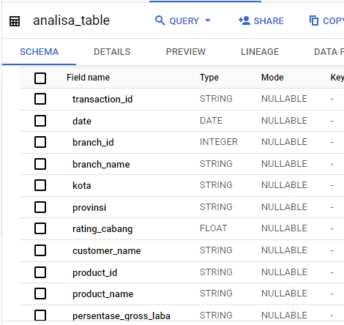
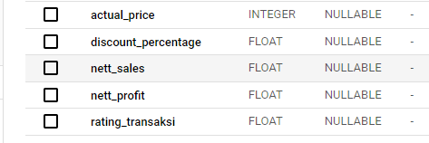
Tabel Analisa
Explain Your Result Here
<You should explain your strategy on this page and you can add image or link result. You can add an explanation of how you got the result also.>
Link:
https://github.com/suciwuland/Rakamin_KF_Analytics/blob/main/analisa_table.csv

Slide 8
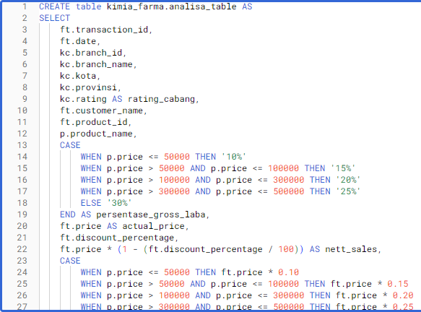
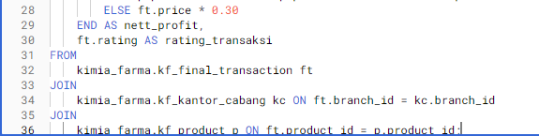
BigQuery Syntax
Link:
https://github.com/suciwuland/Rakamin_KF_Analytics/blob/main/Query_analisa_table

Slide 9
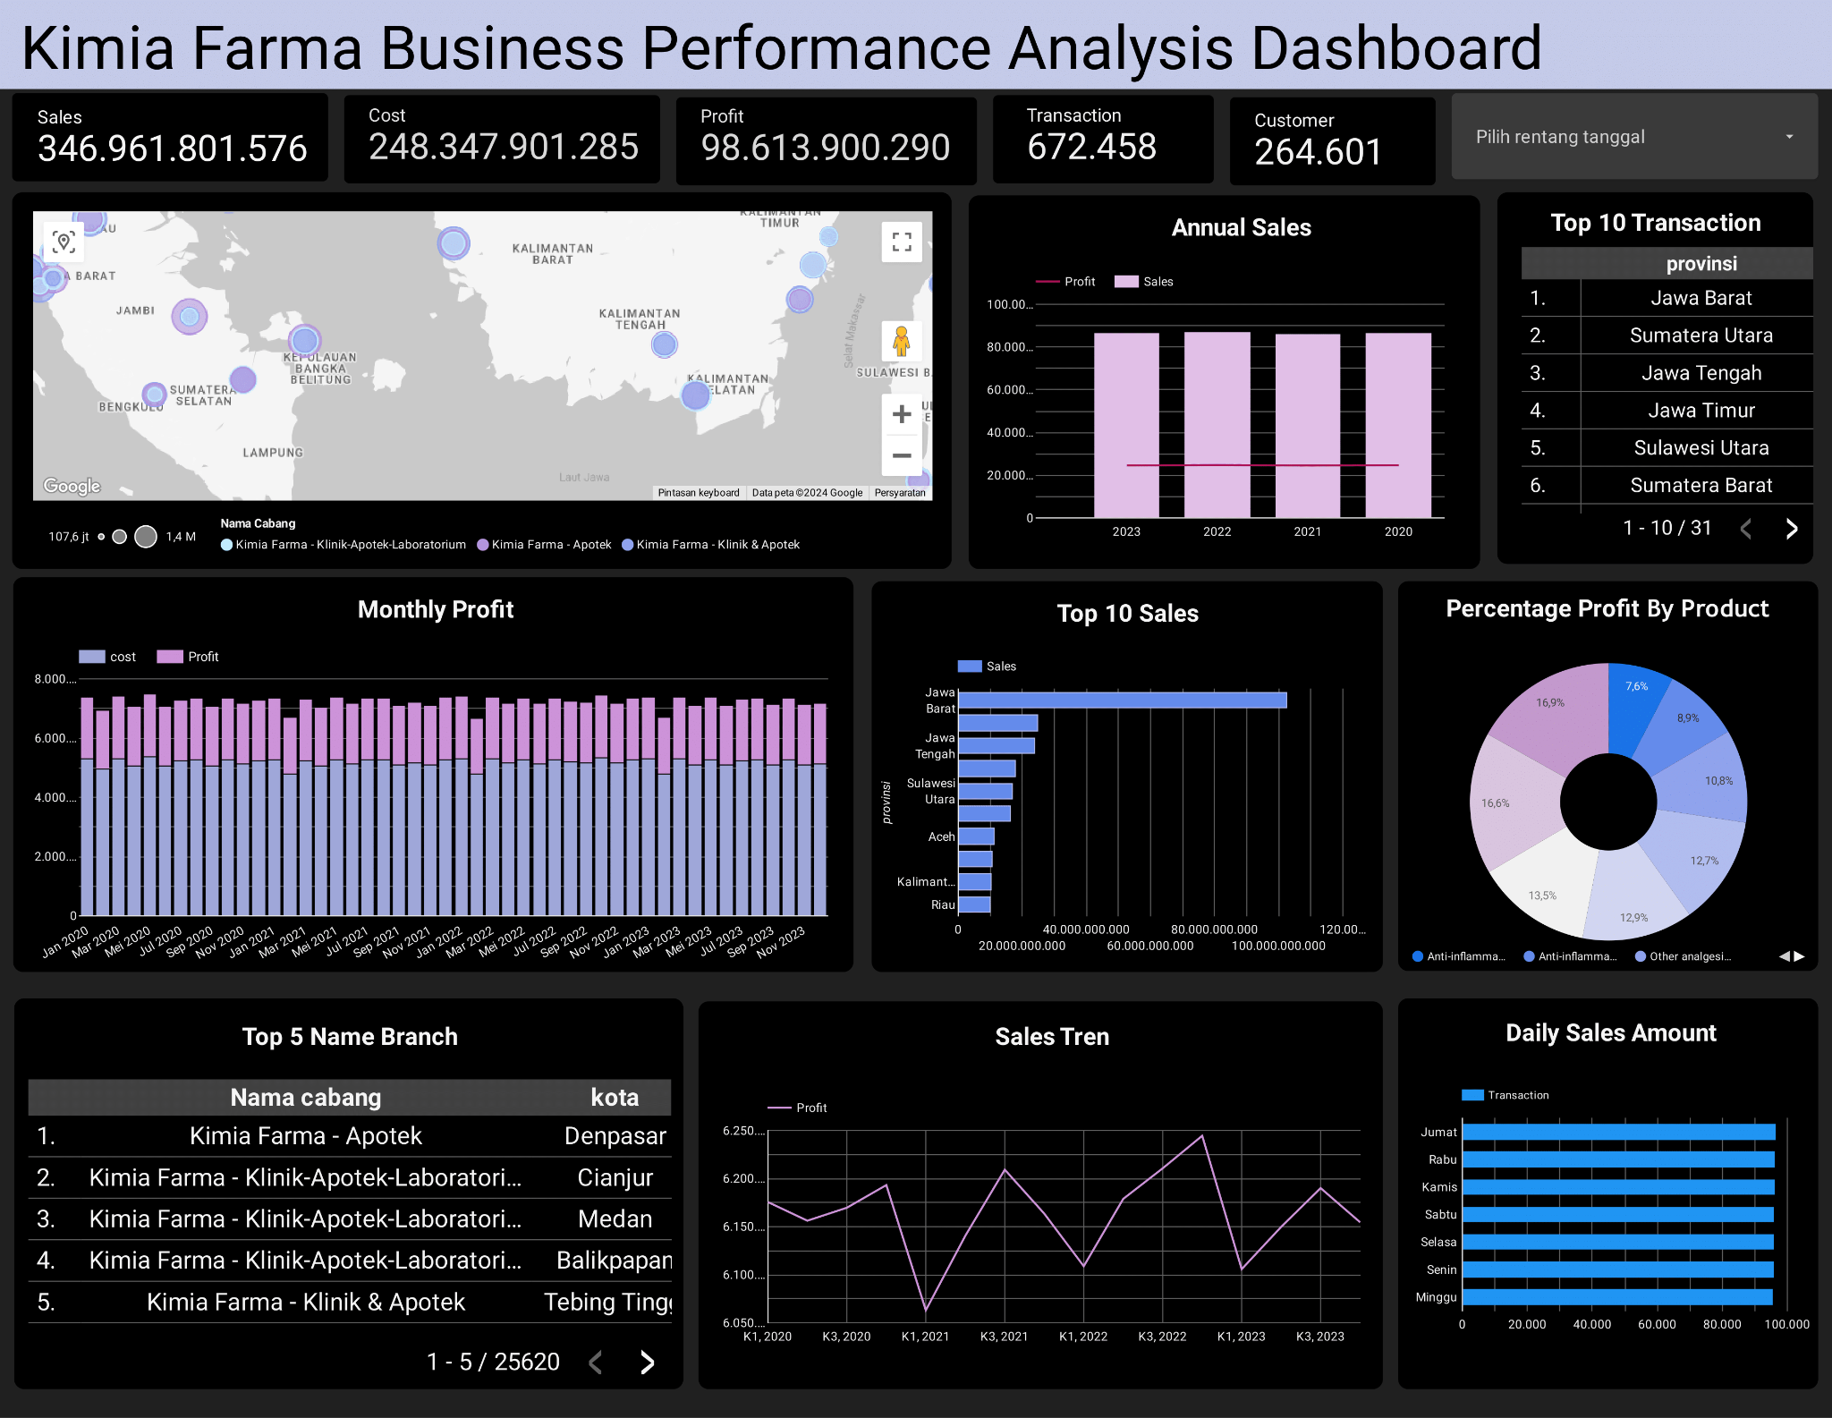
Dashboard Performance Analytics
Link:
https://lookerstudio.google.com/reporting/136e3b0c-139f-47ea-9ee1-7baa957aa5f8

Slide 10
Summary
From the dashboard analysis, several conclusions were drawn to improve business performance for the next year:
1. improve the quality of branch services
2. optimize sales strategy
3. stock management
4. understand business performance in each province

Slide 11
Thank You
X

